Slide 1
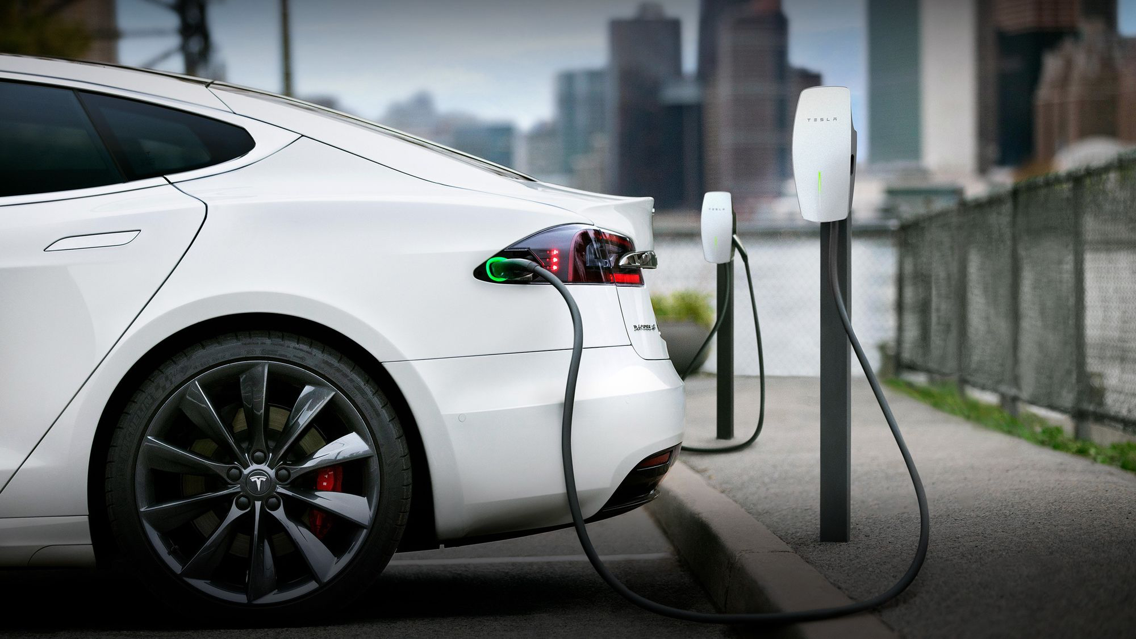

Reinforcement Learning Project:
Electric Vehicle Smart Charge Scheduling
Team Members :
Salman Yousaf, Hyojun Kim, Jake Leto

Slide 2
Agenda
Our Problem
Goals
Linear Programming Optimization
Reinforcement Learning Environment
Q-learning
Proximal Policy Optimization (PPO)
Results and Findings

Slide 3
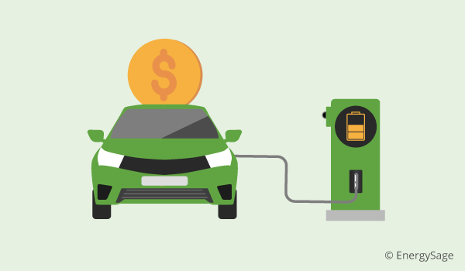
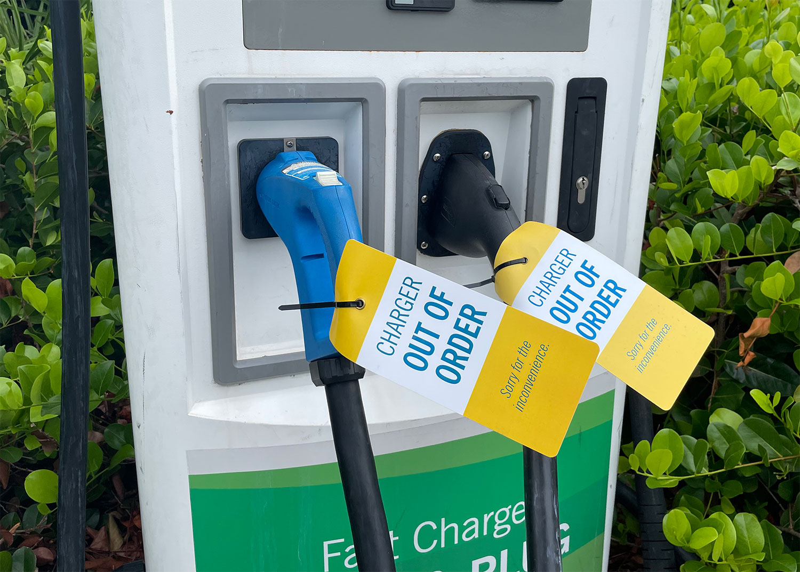
Our Problem
Rapid growth of electric vehicles (EVs) is putting a strain on the power grids and charging systems, with expected net peak power demand to increase by 50%¹ by 2035. This may lead to:
Electricity equipment failure ¹
As the electricity grid may not be equipped to sustain 40% of this projected EV adoption¹
Higher energy costs ²
Managing peak tariffs can reduce EV charging costs by upto 60%, by shifting charging to off-peak hours²
Cost
60%
Notes:
The rapid adoption of electric vehicles (EVs) is putting a strain on our power grids and charging systems. As EV ownership continues to soar, we are witnessing a projected 50% increase in net peak demand by 2035. This surge in demand poses significant challenges, including:
Equipment Failure: The electricity grid may not be equipped to handle this substantial increase in demand, leading to equipment failures and disruptions.
Higher Energy Costs: The increased demand during peak hours can lead to higher energy costs, especially for EV owners who charge their vehicles during these times.
Electricity demand fluctuates throughout the day; demand is higher during daytime hours, peaking in the early evening. If many people buy electric vehicles and mostly try to charge right when they get home from work — as many currently do — the system could get overloaded or force utilities to deliver more electricity than they’re currently capable of producing.
https://www.nature.com/articles/s41560-022-01105-7
https://www.jdpower.com/cars/shopping-guides/ev-drivers-less-satisfied-with-public-charging
The rapid growth of electric vehicles (EVs) is putting a strain on power grids and charging systems, with expected net peak demand increase by upto 50%¹ by 2035 leading to:
Dissatisfied EV users - study found that there are 20% of because the station was out of service
A U.S. Department of Energy study found that increased electrification across all sectors of the economy could boost national consumption by as much as 38% by 2050, in large part because of electric vehicles.
Electricity demand fluctuates throughout the day; demand is higher during daytime hours, peaking in the early evening. If many people buy electric vehicles and mostly try to charge right when they get home from work — as many currently do — the system could get overloaded or force utilities to deliver more electricity than they’re currently capable of producing.
In California, for example, the worry is not so much with the state’s overall power capacity, but rather with the ability to quickly ramp up production when demand is high, said the media relations manager for the California Energy Commission
The state projects that electric vehicles will consume 5.4% of the state’s electricity, or 17,000 gigawatt-hours, by 2030.
Charging during off-peak hours would not only allow many electric vehicles to be added to the roads, but also allow utilities to get more use out of power plants that currently run only during the limited peak times.
For 2035 generation: We find that peak net electricity demand increases by up to 25% with forecast adoption and by 50% in a stress test with full electrification.
https://www.nature.com/articles/s41560-022-01105-7
A whopping 20 percent of respondents who went to a public charging station didn’t even charge their vehicle. The reason for this—cited by 72 percent of those who didn’t charge—is that the station was somehow broken or out of service.
In places with more EVs, like California and the Pacific Northwest, there are more chargers—but still not enough.
https://www.jdpower.com/cars/shopping-guides/ev-drivers-less-satisfied-with-public-charging

Slide 4
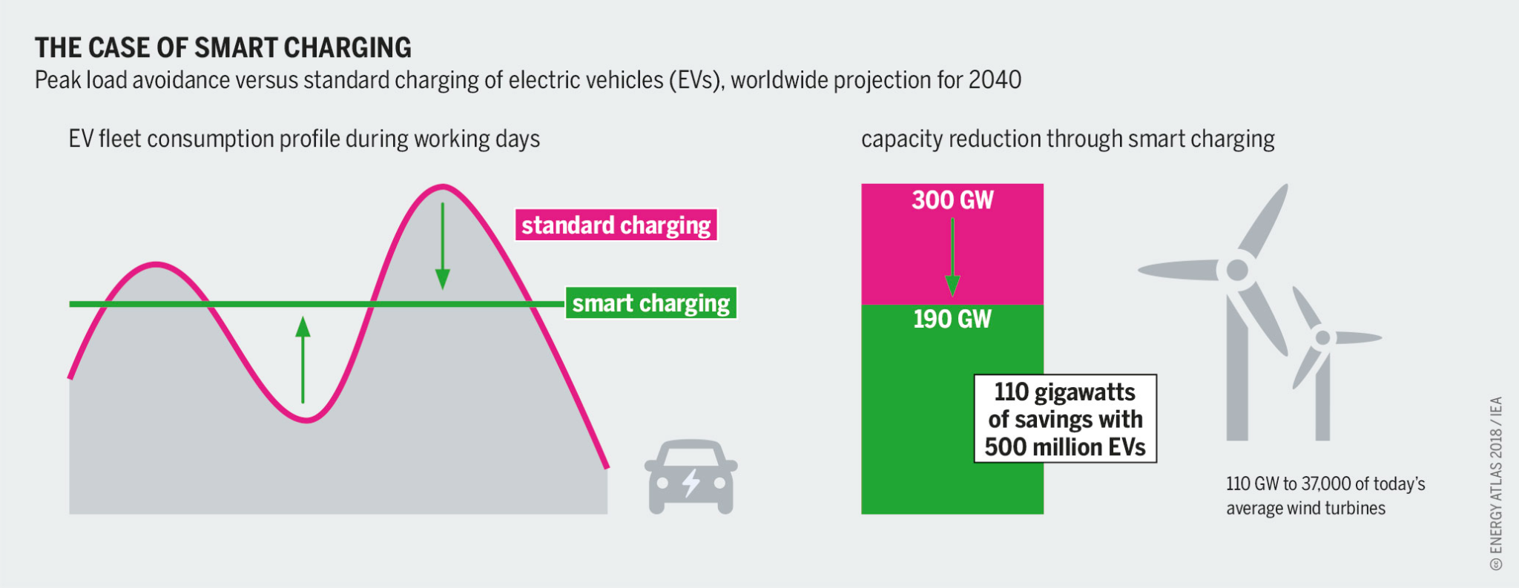
What is ‘EV Charge Scheduling’?
Optimizing schedules for charging Electric Vehicles that leverages user flexibility to achieve:
Improved electricity grid power management
Greater user satisfaction
Power
Consumption
Time

Slide 5
Goal 1
Optimize Electric Vehicle charging schedules using Linear Programming
Goal 2
Replicate Optimization using Reinforcement Learning
Goal 2.1
Create a Reinforcement Learning framework for EV charge scheduling
Goal 2.2
Achieve Optimization using Q-Learning
Goal 2.3
Achieve Optimization using PPO

Slide 6
Our Simulation Data
We generated data for simulations to be used in our Linear Programming and Reinforcement Learning environment
Based on a distribution for actual ranges for Electric Vehicle user’s charging sessions
Contains details for charging sessions, such as:
EV arrival time
EV departure time
amount of energy requested by EV
maximum power draw limit of the EV

Slide 7
Linear Programming Model Framework
Maximize a singular minimum percentage-requested charge value for all EVs
Use any remaining power to maximize total sum of percentage-requested charge achieved for all EVs
Objective Function
Objective Function
Find minimum Peak Power Demand that satisfies full charging for all EVs
Ensure total power consumption is within Peak Power demand at all times
Constraints

Slide 8
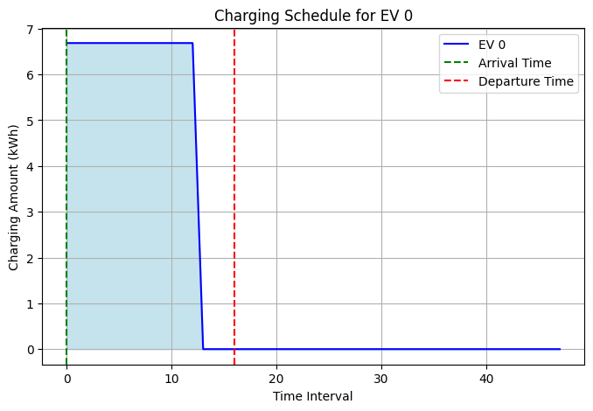
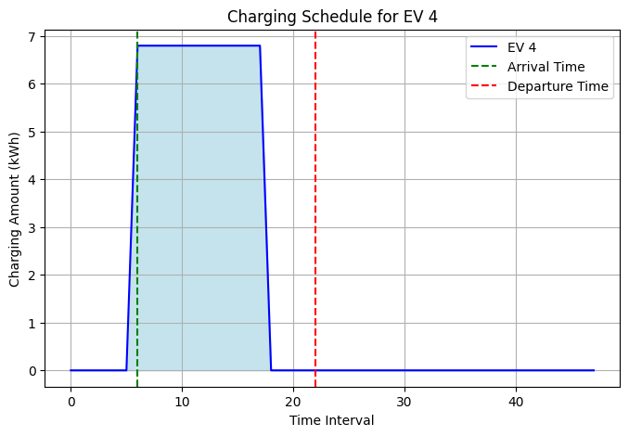
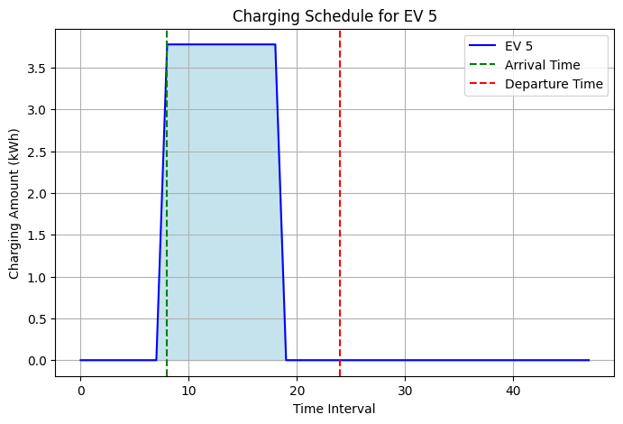
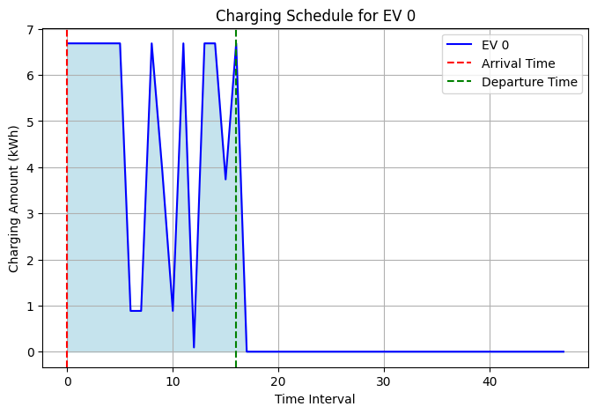
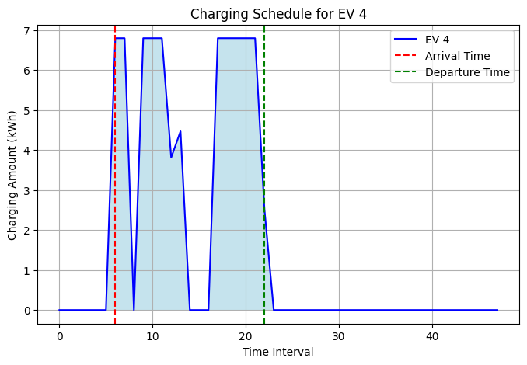
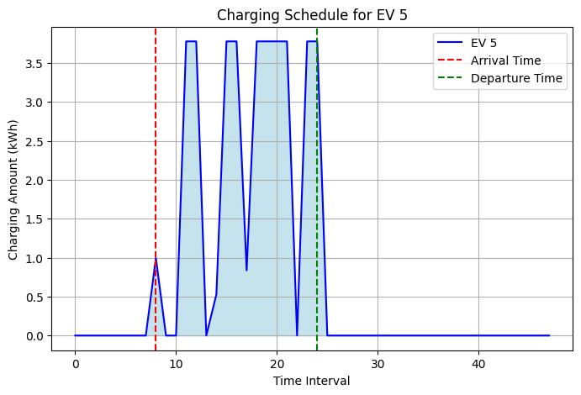
Linear Programming Model Results
Unoptimized
After Optimization

Slide 9
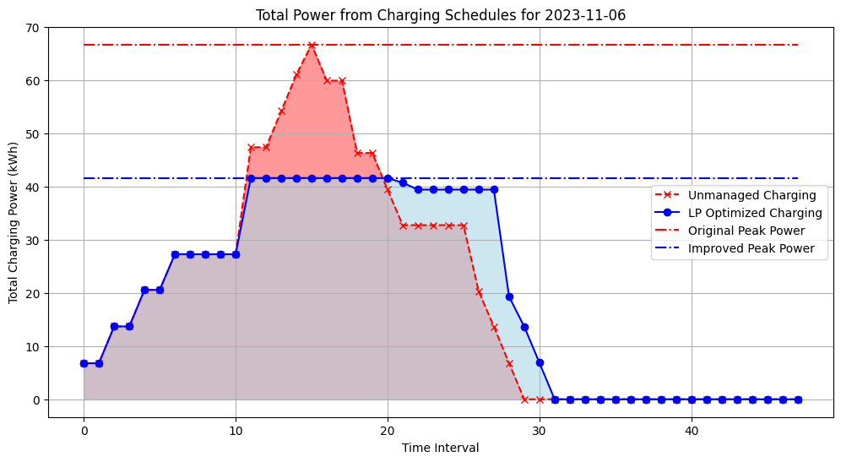
Achieved Successful Reduction in Peak Power Demand
Using LP Optimized Charging Schedules
Simulated charge scheduling on actual EV data from Argonne National Lab for November 6, 2023

Slide 10
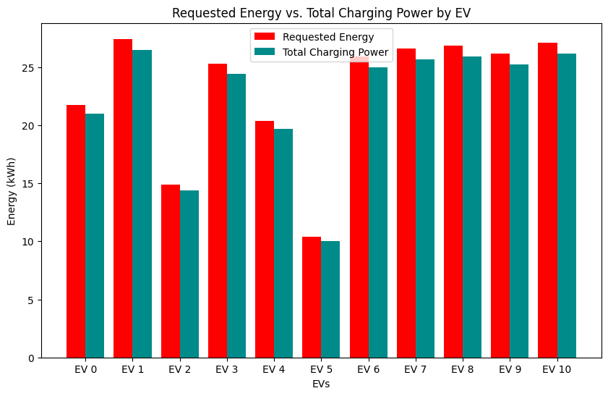
Linear Programming Model Optimized Results

Slide 11
Charge Scheduling using Reinforcement Learning

Slide 12
Reinforcement Learning for EV Charge Scheduling
The following characteristics of the problem make RL a promising solution:
Optimization
Dynamic Environment
Complex decision making
Personalization
Scalability
RL and LP are suitable for optimization problems
EV charging demand is subject to fluctuations and the charging infrastructure is continuously changing
Various factors for decision making are involved
RL / LP models can personalize the charging schedule based on individual driver behavior and preferences
RL / LP can scale up to large-scale EV charging networks and handle the coordination of multiple charging stations and EVs

Slide 13
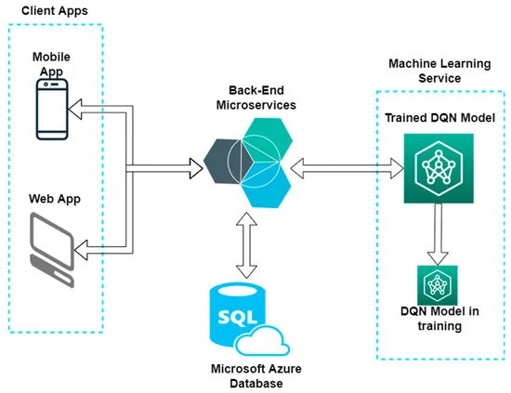
Literature Review -
Charge Scheduling using Reinforcement Learning
We reviewed how Reinforcement Learning was used by existing literature to solve charge scheduling problems
For example, some researchers¹ proposed a smart charging scheduling Deep Q-Network (DQN) model, while others used a PPO (Proximal Policy Optimization) algorithm
Alternatives include a reservation-based algorithm for smart charging of EVs in shared charging environments using Q-Learning
We will be attempting Q-Learning and PPO in our approach
[1] Viziteu, A., Furtună, D., Robu, A., Senocico, S., Cioată, P., Baltariu, M. R., Filote, C., & Raboaca, M. S. (2022). Smart Scheduling of Electric Vehicles Based on Reinforcement Learning. Sensors, 22(10), 3718. https://doi.org/10.3390/s22103718
[2] Flocea, R., Hîncu, A., Robu, A., Senocico, S., Traciu, A., Remus, B. M., Răboacă, M. S., & Filote, C. (2022). Electric Vehicle Smart Charging Reservation Algorithm. Sensors, 22(8), 2834. https://doi.org/10.3390/s22082834
Notes:
Ill talk about some of the literatures we referenced to help us determine our methodologies and guidance on how to approach the problem
This literature proposed a smart charging scheduling Deep Q-Network (DQN) model that takes in consideration of battery level, trip distance, nearby charging stations, appointments, and average speed. The model utilizes simulated scenarios for creating new datasets and neural networks to identify optimal charging stations and time intervals for charging.
They also performed several experiments based on the scenarios generated by the simulator.
▪ Environment: Simulation of three interconnected cities, total distance of 25 km;
▪ Generated cars: 400 cars with a random initial position and random destination points.
The model used a DQN with a simple neural network (a single hidden layer of 16 neurons)
They developed and trained the neural network that uses a history of the situations encountered thus far to identify the optimal charging station and time interval for recharging
Limitations: Because the training data are generated by a simulator, they rarely resemble real-world data. If the DQN algorithm encounters situations that differ significantly from the scenarios in the training datasets, it may make incorrect decisions.
However, In our project, we use real-world data to train and create simulation of peak consumption, but our take on the DQN model is similar to this project

Slide 14
Reinforcement Learning Environment
We consider Epsilon-Greedy for Q-Learning and Actor-Critic for Proximal Policy Optimization (PPO).
Environment
Power Grid, properties of our EV Users, Charging Stations
Agent
EV Charging Station
State
State is the current condition of our environment (available power, current battery charge of EVs etc.)
Action
Amount of power distributed to each EV per time unit
Reward
A function of the current power demand by the EV charging stations on the grid, and the charging state of the EVs with respect to their expected departure times
Notes:
In the context of EV smart charging, the agent is the EV charging system, and the environment is the power grid and the characteristics of the EV users.
The agent's goal is to learn a policy that minimizes peak demand on the grid while maximizing the utilization of cost-effective energy sources.
We have created a simulation environment to train and test our RL model.
The choice of which RL model to use for learning will depend on the specific characteristics of our environment and our final state / rewards framework.

Slide 15
Q-Learning

Slide 16
LP vs Q-Learning
Limitations of LP:
Only Excellent for structured problems with clear, linear relationships
Struggles with stochastic (random) elements and dynamic changes, common in real-world scenarios
Enter Q-Learning:
Thrives in uncertain, complex environments
Does not require a predefined model of the environment, making it versatile and adaptive
Application in EV Charging:
Optimizing EV charging schedules in fluctuating conditions

Slide 17
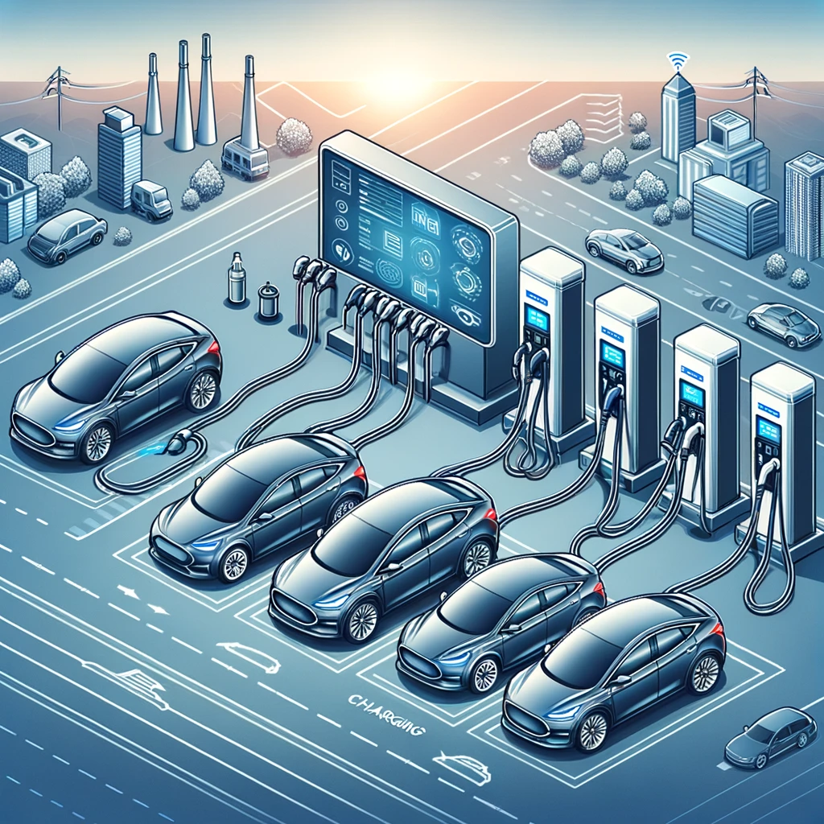
Setting Up the Environment
Key Parameters:
NUM_USERS:
Represented by the number of cars (5) at the station
NUM_CHARGE_STATES:
Indicated by the battery levels shown on the displays (0-100%)
NUM_TIME_STATES:
Split into 10 separate intervals, varying electricity costs or different EV charging demands
MAX_STEPS:
The total number of actions the simulation allows before it restarts
MAX_POWER:
Maximum power output that the charging station can deliver

Slide 18
Implementing Q-Learning
Q-Learning Algorithm Implementation
Learning Dynamics:
Systematically updates the Q-table based on rewards from charging actions to improve decision-making over time
Epsilon-Greedy Strategy for Decision-Making
Exploration and Exploitation:
Initially experiments with a variety of charging actions to gather diverse data (exploration) and gradually shifts to using the most successful strategies identified (exploitation)
Strategy:
Over time, ε decays (decreases) gradually, shifting the focus more towards exploitation, as the agent is expected to have learned from its earlier explorations

Slide 19
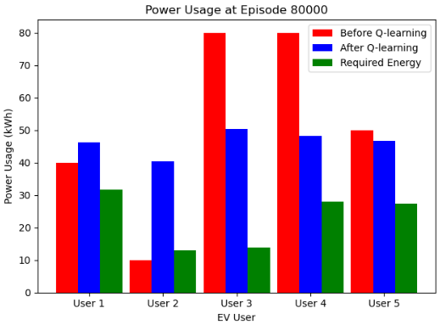
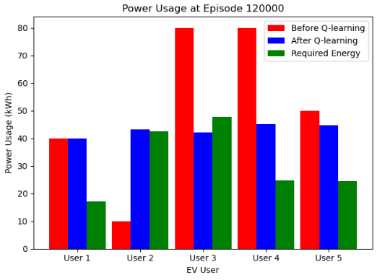
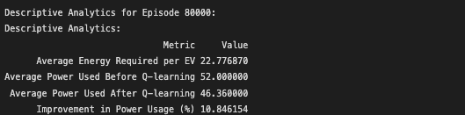
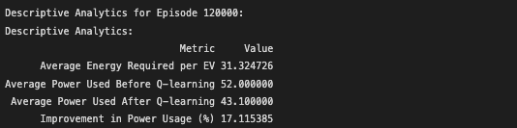
Evaluating Agent Performance

Slide 20
Beyond Q-Learning’s Limits
Advancing to PPO
Handling Complex Environments:
Better suited for dynamic, complex scenarios in EV charging with enhanced learning capabilities
Improved Scalability and Efficiency:
Efficiently manages fluctuating conditions, ideal for large-scale EV charging systems
Challenges in Q-Learning
Complex State Representation:
Expanding Q-table size with more EVs and scenarios increases computational demands
Adaptability to Dynamic Environments:
Struggles with rapid changes, requiring frequent updates or retraining

Slide 21
PPO

Slide 22
PPO
Introduced by OpenAI in 2017
Created as a means for handling the limitations of policy gradient methods
Slowly updates policy to avoid drastic changes in results
Flexible and easy to tune
Multiple variations and implementations
Works for both discrete and continuous action spaces
PPO, PPO2, ACER, TRPO

Slide 23
Environment Changes for PPO
Reframe problem to help with convergence issues
Environment
Power Grid, properties of our EV Users, Charging Stations
Agent
EV Charging Station
State
Energy remaining until fully charged, steps until departure
Action
Percentage of maximum current supplied to vehicle
Reward
+1 if vehicle is charged before required departure, -1 if vehicle leaves before fully charging
Notes:
In the context of EV smart charging, the agent is the EV charging system, and the environment is the power grid and the characteristics of the EV users.
The agent's goal is to learn a policy that minimizes peak demand on the grid while maximizing the utilization of cost-effective energy sources.
We have created a simulation environment to train and test our RL model.
The choice of which RL model to use for learning will depend on the specific characteristics of our environment and our final state / rewards framework.

Slide 24
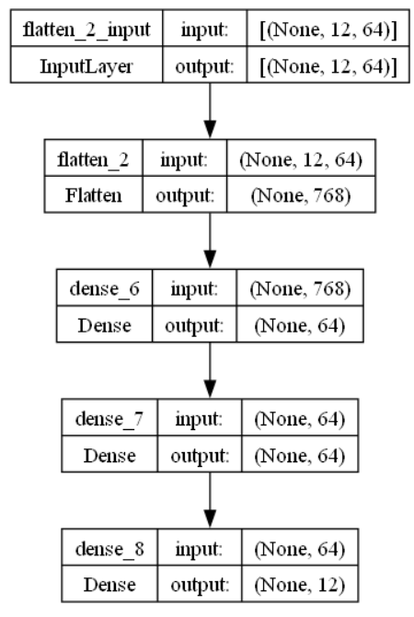
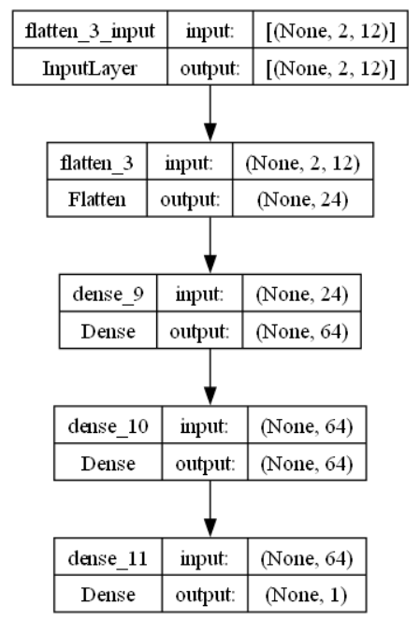
PPO
Actor
Critic

Slide 25
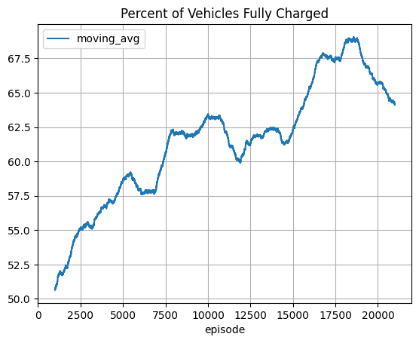
Summary of Results
Percentage of fully charged vehicles is increasing slightly over each episode
Results show promise for the methodology
Adjust reward mechanism to penalize incrementally (not just end of episode)
Optimize actor-critic network structure
Change activation functions
Vary neurons on in the hidden layer

Slide 26
Thank You

Slide 27
Appendix
https://www.nature.com/articles/s41560-022-01105-7
https://www.jdpower.com/cars/shopping-guides/ev-drivers-less-satisfied-with-public-charging
https://ieeexplore.ieee.org/stamp/stamp.jsp?tp=&arnumber=9932586
https://www.mdpi.com/1996-1073/16/3/1213

Slide 28
Why Multi-Objective Linear Programming?
The following characteristics of the problem make multi-objective linear programming(MOLP) a promising solution:
Optimization
Dynamic Environment
Complex decision making
Personalization
Scalability
MOLP is suitable for optimization problems
EV charging demand, charging window, and power availability change rapidly in real-world scenario
Various factors are considered in decision making, and optimizing one objective may impact others, so a balance needs to be achieved with all of our objectives
MOLP models can personalize the charging schedule based on individual EV’s charging window and power demand
MOLP can scale up to large-scale EV charging networks and handle the coordination of multiple charging stations and EVs

Slide 29
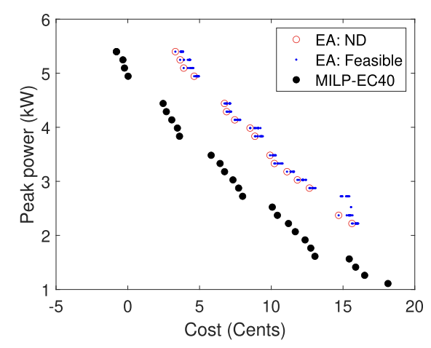
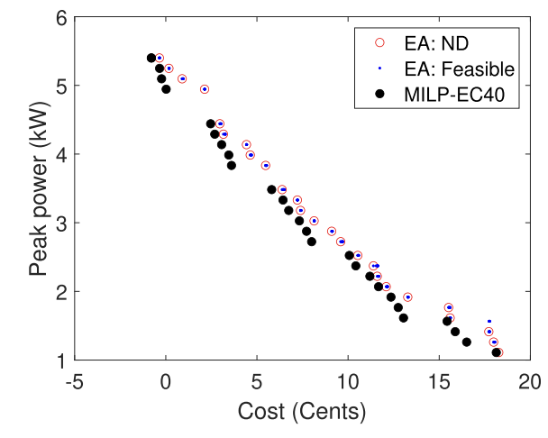
Literature Review Summary - LP
Singh, H. K., Ray, T., Rana, J., Limmer, S., Rodemann, T., & Olhofer, M. (2022). Investigating the Use of Linear Programming and Evolutionary Algorithms for Multi-Objective Electric Vehicle Charging Problem. IEEE Access, 10, 115322–115337. https://doi.org/10.1109/access.2022.3218058
Article Proposal: Examined efficient EV charging scheduling, comparing evolutionary algorithms (EAs) and mixed-integer linear programming (MILP) for optimizing costs and grid peak power.
Overview: Detailed MILP formulation for EV charging, focusing on charging/discharging patterns and peak power management. Compared with EAs for handling multiple objectives like cost and power efficiency.
Conclusion: Through numerical experiments, evaluated EAs and MILP effectiveness in multi-objective optimization. Used metrics like hypervolume and inverted generational distance to assess solution quality and applicability for EV charging problems.
Notes:
https://ieeexplore.ieee.org/stamp/stamp.jsp?tp=&arnumber=9932586

Slide 30
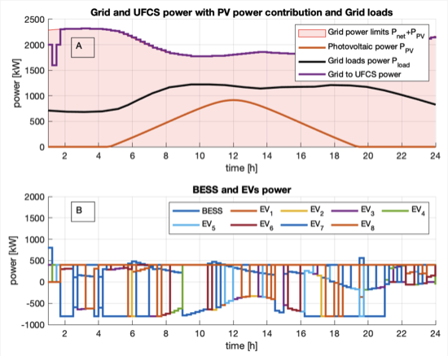
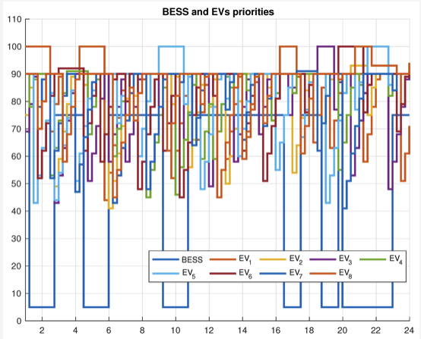
Literature Review Summary - LP
Rubino, L., Rubino, G., & Esempio, R. (2023). Linear Programming-Based Power Management for a Multi-Feeder Ultra-Fast DC Charging Station. Energies, 16(1213). https://www.mdpi.com/1996-1073/16/3/1213
Authors proposed a linear programming method that optimizes charging efficiency in a simulated environment of Multi-feeder Ultra-fast Charging.
Algorithm optimized the charging process by managing power flow and setting priorities for vehicles.
The study concluded that the linear programming approach efficiently manages the power distribution without exceeding grid limit, offering a scalable and cost-effective solution for ultra-fast stations.
Notes:
https://www.mdpi.com/1996-1073/16/3/1213

